Slide 1
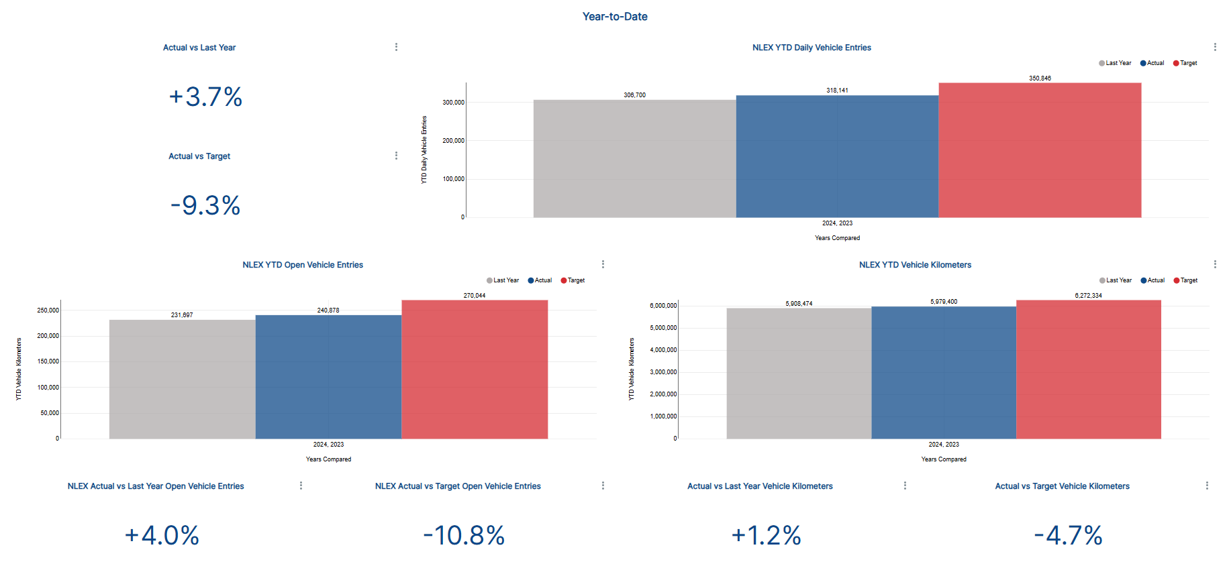
MPT North - NLEX Traffic Monitoring [TPCPO Latest Feed]
1
3
2
4
5
6
7
8
9

Slide 2
1
Actual vs Last Year
SELECT (sum("YTD_NLEX_Veh_Entries")-sum("Previous_YTD_NLEX_Veh_Entries"))/sum("Previous_YTD_NLEX_Veh_Entries") AS "(sum(""YTD_NLEX_Veh_Entries"")-sum(""Previo..."
FROM public.tpcpo_north_ytd_summary;
2
Actual vs Target
SELECT (sum("YTD_NLEX_Veh_Entries")-sum("NLEX_Target_Daily_VE"))/sum("NLEX_Target_Daily_VE") AS "(sum(""YTD_NLEX_Veh_Entries"")-sum(""NLEX_T..."
FROM public.tpcpo_north_ytd_summary;
3
NLEX YTD Daily Vehicle Entries
SELECT "Year" AS "Year",
"Previous_Year" AS "Previous_Year",
sum("Previous_YTD_NLEX_Veh_Entries") AS "Last Year",
sum("YTD_NLEX_Veh_Entries") AS "Actual",
sum("NLEX_Target_Daily_VE") AS "Target"
FROM public.tpcpo_north_ytd_summary
GROUP BY "Year",
"Previous_Year"
ORDER BY "Last Year" ASC
LIMIT 10000;

Slide 3
4
NLEX YTD Open Vehicle Entries
SELECT "Year" AS "Year",
"Previous_Year" AS "Previous_Year",
sum("Previous_YTD_NLEX_Open_Veh_Entries") AS "Last Year",
sum("YTD_NLEX_Open_Veh_Entries") AS "Actual",
sum("NLEX_Target_Daily_OVE") AS "Target"
FROM public.tpcpo_north_ytd_summary
GROUP BY "Year",
"Previous_Year"
ORDER BY "Last Year" ASC
LIMIT 10000;
5
NLEX YTD Vehicle Kilometers
SELECT "Year" AS "Year",
"Previous_Year" AS "Previous_Year",
sum("Previous_YTD_NLEX_Open_Veh_Entries") AS "Last Year",
sum("YTD_NLEX_Open_Veh_Entries") AS "Actual",
sum("NLEX_Target_Daily_OVE") AS "Target"
FROM public.tpcpo_north_ytd_summary
GROUP BY "Year",
"Previous_Year"
ORDER BY "Last Year" ASC
LIMIT 10000;

Slide 4
6
NLEX Actual vs Last Year Open Vehicle Entries
SELECT (sum("YTD_NLEX_Open_Veh_Entries")-sum("Previous_YTD_NLEX_Open_Veh_Entries"))/sum("Previous_YTD_NLEX_Open_Veh_Entries") AS "(sum(""YTD_NLEX_Open_Veh_Entries"")-sum(""P..."
FROM public.tpcpo_north_ytd_summary;
7
NLEX Actual vs Target Open Vehicle Entries
SELECT (sum("YTD_NLEX_Open_Veh_Entries")-sum("NLEX_Target_Daily_OVE"))/sum("NLEX_Target_Daily_OVE") AS "(sum(""YTD_NLEX_Open_Veh_Entries"")-sum(""N..."
FROM public.tpcpo_north_ytd_summary;
8
Actual vs Last Year Vehicle Kilometers
SELECT (sum("YTD_NLEX_VehKm")-sum("Previous_YTD_NLEX_VehKm"))/sum("Previous_YTD_NLEX_VehKm") AS "(sum(""YTD_NLEX_VehKm"")-sum(""Previous_YTD..."
FROM public.tpcpo_north_ytd_summary;
9
Actual vs Target Vehicle Kilometers
SELECT (sum("YTD_NLEX_VehKm")-sum("NLEX_Target_Daily_KM"))/sum("NLEX_Target_Daily_KM") AS "(sum(""YTD_NLEX_VehKm"")-sum(""NLEX_Target_..."
FROM public.tpcpo_north_ytd_summary;

Slide 5
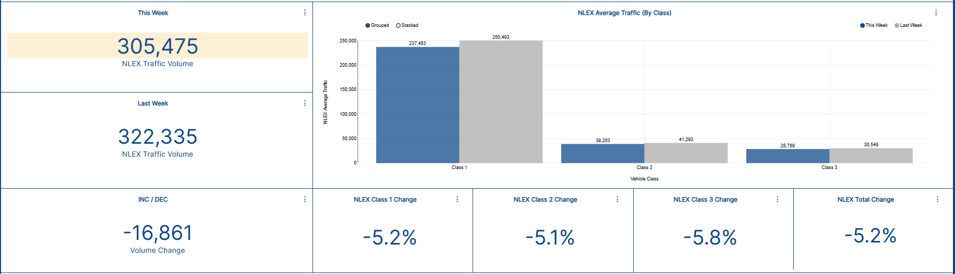
1
4
2
3
5
6
7
8

Slide 6
1
This Week
SELECT SUM("NLEX_SumVehEntries")/7 AS "SUM(""NLEX_SumVehEntries"")/7"
FROM public.tpcpo_north_weekly_bignum
WHERE "Week_Range" IN ('2023-08-21 - 2023-08-27');
2
Last Week
SELECT SUM("Prev_NLEX_SumVehEntries")/7 AS "SUM(""Prev_NLEX_SumVehEntries"")/7"
FROM public.tpcpo_north_weekly_bignum
WHERE "Week_Range" IN ('2023-08-21 - 2023-08-27');
3
INC/DEC
SELECT SUM("NLEX_Vol_Change")/7 AS "SUM(""NLEX_Vol_Change"")/7"
FROM public.tpcpo_north_weekly_bignum
WHERE "Week_Range" = '2023-08-21 - 2023-08-27';
4
INC/DEC
SELECT "Class_Name" AS "Class_Name",
SUM("NLEX_SumVehEntries")/7 AS "This Week",
SUM("Prev_NLEX_SumVehEntries")/7 AS "Last Week"
FROM public.tpcpo_north_weekly_bignum
WHERE "Week_Range" IN ('2023-08-21 - 2023-08-27')
GROUP BY "Class_Name"
ORDER BY "This Week" DESC
LIMIT 1000;

Slide 7
5
NLEX Class 1 Change
SELECT sum("Perc_NLEX_Vol_Change") AS "SUM(Perc_NLEX_Vol_Change)"
FROM public.tpcpo_north_weekly_bignum
WHERE "Class_Name" = 'Class 1'
AND "Week_Range" = '2023-08-21 - 2023-08-27';
6
NLEX Class 2 Change
SELECT sum("Perc_NLEX_Vol_Change") AS "SUM(Perc_NLEX_Vol_Change)"
FROM public.tpcpo_north_weekly_bignum
WHERE "Week_Range" IN ('2023-08-21 - 2023-08-27')
AND "Class_Name" = 'Class 2';
7
NLEX Class 3 Change
SELECT sum("Perc_NLEX_Vol_Change") AS "SUM(Perc_NLEX_Vol_Change)"
FROM public.tpcpo_north_weekly_bignum
WHERE "Class_Name" = 'Class 3'
AND "Week_Range" IN ('2023-08-21 - 2023-08-27');
8
NLEX Total Change
SELECT ("NLEX_SumVehEntries"-"Prev_NLEX_SumVehEntries")/"Prev_NLEX_SumVehEntries" AS "(""NLEX_SumVehEntries""-""Prev_NLEX_SumVehE..."
FROM public.tpcpo_north_weekly_bignum
WHERE "Week_Range" IN ('2023-08-21 - 2023-08-27');
Note: We acknowledge that the date ranges differ.

